Slide 1
INTRODUCTION | MILESTONE 4 |
Risk Analytics on the dashboard
Prediction AI
54%
46%
Dashboard & Deployment
Overall risk
Success probability
Startup & Project Risk Analyzer. Teams often invest in an idea without seeing the market, budget and planning risks behind most failures. The app predicts those risks and recommends how to reduce them.
40%
30%
Market risk
Tech risk
Milestone 4 builds the risk analytics dashboard and assessment reports, then tests, optimizes and deploys the app.
Targets: reports in under 5 seconds, user satisfaction of 85% or higher.
Notes:
Introduce the project and Milestone 4 (weeks 7-8): the risk analytics dashboard, comprehensive assessment reports, then testing, optimization and deployment. The four tiles preview the dashboard: overall risk, success probability, market risk and tech risk for a sample project. Evaluation targets: dashboard fully operational, reports within 5 seconds, user satisfaction of 85% or higher.

Slide 2





Tech Stack
Tools used to build, test and deploy Milestone 4
Python
CORE LANGUAGE
Backend logic, database access and report generation, with one module per engine.
Streamlit
WEB DASHBOARD
Four tabs; the Dashboard tab shows risk analytics and the assessment report.
Google Gemini
LLM REASONING
Writes the strategic insights and recommendations shown on the dashboard.
LangGraph
AGENT WORKFLOW
Runs the connected analysis nodes that feed the final report.
SQLite
LOCAL DATABASE
Stores projects, risks, recommendations, mitigations and improvements.
2 / 7
Notes:
Python for the modular backend, Streamlit for the dashboard tabs, Gemini for strategic reasoning, LangGraph for the agent workflow, and SQLite as the local database. Testing and deployment of the final app are the focus of this milestone.

Slide 3
System Flow
From project input to the dashboard and exportable report
Built in Milestones 1-3
New in Milestone 4
Input
Project analysis
Risk analysis
Recommend & mitigate
Final response
Dashboard & report
Project info, budget and target market
Market and competitor context
Risk score, SWOT and feasibility
Gemini advice through the LangGraph agent
Combined result saved to SQLite
Risk analytics, assessment report, Export and Share
Saved results feed everything
Every stage writes to SQLite. The dashboard and the exported report read the same saved results, so the numbers always match.
3 / 7
Notes:
Walk left to right. Input, project analysis, risk analysis and the LangGraph recommendation and mitigation steps were built in Milestones 1-3. The final response is saved to SQLite. Milestone 4 adds the last step: the risk analytics dashboard and the exportable assessment report, both reading the same saved data.

Slide 4
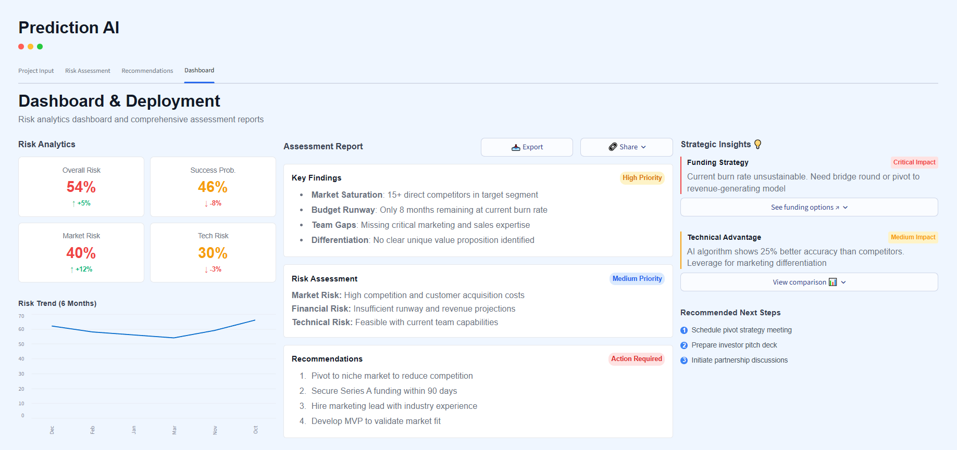



Working
Milestone 4: Dashboard & Deployment in the running app
Risk analytics
Overall risk, success probability, market and tech risk with change indicators, plus a 6-month trend.
Assessment report
Key findings, risk assessment and recommendations, with Export and Share buttons.
Strategic insights
Funding strategy and technical advantage, plus recommended next steps.
Demo path: open the Dashboard tab > read the risk analytics > review the assessment report > Export or Share
4 / 7
Notes:
Live demo for Milestone 4 only. 1) Risk analytics: overall risk 54%, success probability 46%, market risk 40%, tech risk 30%, with the 6-month risk trend. 2) Assessment report: key findings (15+ competitors, 8 months of runway), risk assessment and four recommendations; use Export or Share. 3) Strategic insights: funding strategy (critical impact), technical advantage (medium impact) and the recommended next steps.

Slide 5
Database Structure
Milestone 4: the tables behind the dashboard, the assessment report and Export
Success_Predictions
prediction_id (PK), project_id (FK), success_probability, overall_risk_score, prediction_date
Feeds the Overall Risk and Success Prob. tiles
Projects
one row per analysed project
project_id (PK)
user_id (FK)
project_name
project_type
budget
target_market
description
created_at
Risk_Assessments
risk_id (PK), project_id (FK), risk_category, risk_score, risk_description, priority_level
Feeds the Market Risk and Tech Risk tiles
Recommendations
recommendation_id (PK), project_id (FK), recommendation_text, risk_mitigation, priority, generated_at
Feeds the report recommendations
Assessment_Reports
report_id (PK), project_id (FK), report_path, generated_at
Stores the report used by Export and Share
The result tables link back through project_id; Analytics_Logs links through user_id.
Analytics_Logs
log_id (PK), user_id (FK), activity_type, timestamp
Tracks usage during testing
5 / 7
Notes:
Milestone 4 reads from a small set of tables. Projects holds the project details. Success_Predictions feeds the Overall Risk and Success Probability tiles, Risk_Assessments feeds the Market Risk and Tech Risk tiles, Recommendations feeds the recommendations in the assessment report, Assessment_Reports stores the generated report used by Export and Share, and Analytics_Logs tracks activity during testing. The result tables link back to a project through project_id, and Analytics_Logs links through user_id. This follows the database schema in the project brief; adjust the names if your SQLite tables differ.

Slide 6


Code
How the dashboard turns saved results into risk tiles and a report
SQLite
>
database.py
>
app.py
>
Streamlit dashboard
app.py (simplified)
1. Load saved results
def render_dashboard(project_id):
# 1. Load saved results from SQLite
project = load_project(project_id)
risks = load_risks(project_id)
recs = load_recommendations(project_id)
risk = project["risk_score"]
# 2. Risk analytics tiles
c1, c2, c3, c4 = st.columns(4)
c1.metric("Overall Risk", f"{risk}%")
c2.metric("Success Prob.", f"{100 - risk}%")
c3.metric("Market Risk", f"{category_risk(risks, 'Market')}%")
c4.metric("Tech Risk", f"{category_risk(risks, 'Technical')}%")
# 3. Assessment report
for rec in recs:
st.write(f"{rec['priority']}: {rec['action']}")
# 4. Export the report
st.download_button("Export", build_report(project, risks, recs))
database.py reads the project, its risks and its recommendations from SQLite.
2. Risk analytics tiles
Four metrics: overall risk, success probability (100 minus risk), market risk and tech risk.
3. Assessment report
Each recommendation is listed with its priority and the action to take.
4. Export
One button builds the assessment report so it can be saved or shared.
6 / 7
Notes:
Data flows from SQLite through database.py into app.py, which renders the Streamlit dashboard. The four numbered comments in the code match the four boxes on the right: load the saved results, show the four risk tiles (success probability is 100 minus overall risk), list the recommendations in the assessment report, and export the report. This is a simplified example; replace it with the real code from the project if it differs.

Slide 7



Closure
MILESTONE 4 | DASHBOARD & DEPLOYMENT
Delivered
Testing and deployment
Targets
Risk analytics dashboard
Assessment report with Export and Share
Strategic insights and next steps
End-to-end flow from project input to report
Testing and optimization
Final app prepared for deployment
Dashboard fully operational
Reports in under 5 seconds
User satisfaction of 85% or higher
Prediction AI helps founders and students see the risks before they invest, and gives them clear steps to reduce them.
Thank you
Questions?
Notes:
Wrap up: Milestone 4 delivers the risk analytics dashboard, the assessment report with Export and Share, and strategic insights. The app is tested, optimized and prepared for deployment. Evaluation targets are a fully operational dashboard, reports in under 5 seconds and user satisfaction of 85% or higher. Thank the audience and open for questions.

